Slide 1
Neural Style Transfer
Rishi Shah and Harshil Vagadia

Slide 2
Introduction
Neural Style Transfer tries to leverage deep networks to create artistic images.
Given a content image and a style image, we try to transfer the style to the content image. The algorithm starts with the content image and iteratively transfers the styles.
We provide detailed experimentation on various hyperparameters of the algorithm that will hopefully provide valuable insights on fine-tuning the styled images. All the results in this report are qualitative in nature.

Slide 3
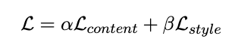
Approach
This algorithm relies on pre-trained deep CNNs to extract features from images. The main paper uses VGG19 model trained on classification task. We experiment with different architectures.
The algorithm is iterative i.e. the quality of output image improves with each run. There are two losses: Content Loss and Style Loss. The overall loss is the weighted combination of both.

Slide 4
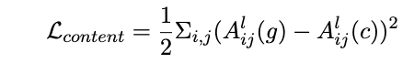
Content Loss
The content loss tries to keep the generate image as close to the content image.
Since CNNs are good at extracting important features from an image, the content loss at a deeper layer in the pretrained network.
The features at deeper layer will only contain the important aspects of an image and ignore the styling part.
Content loss is simply the MSE loss between deep features of content and generated images.
Here the loss is taken for L-th layer and A^{L}(I) represents the features of the L-th layer.

Slide 5
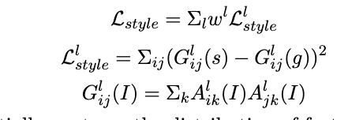
Style Loss
Style loss is generally taken over multiple layers. For each layer, it is the MSE between the gram matrices of the style and generate images.
The Gram matrix essentially captures the distribution of features of a set of feature maps in a given layer. The style loss essentially matches the distribution of features between the two images.

Slide 6
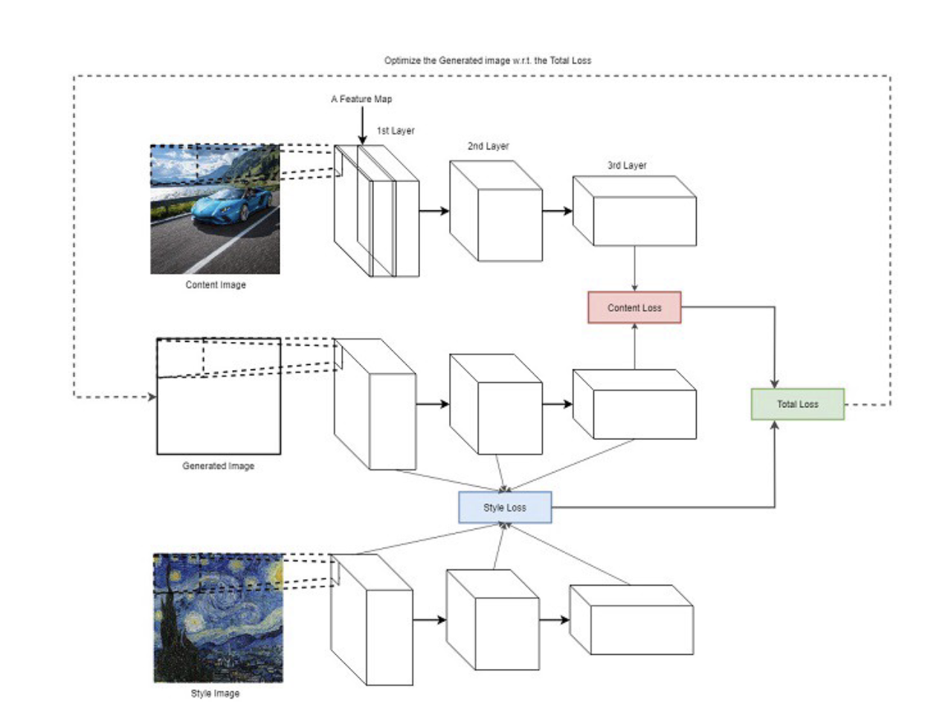
Overall Architecture

Slide 7
Experiments
Changing and working with various hyperparameters of the algorithm that give in-depth analysis of importance and role of each hyperparameter.
Results & Inferences

Slide 8
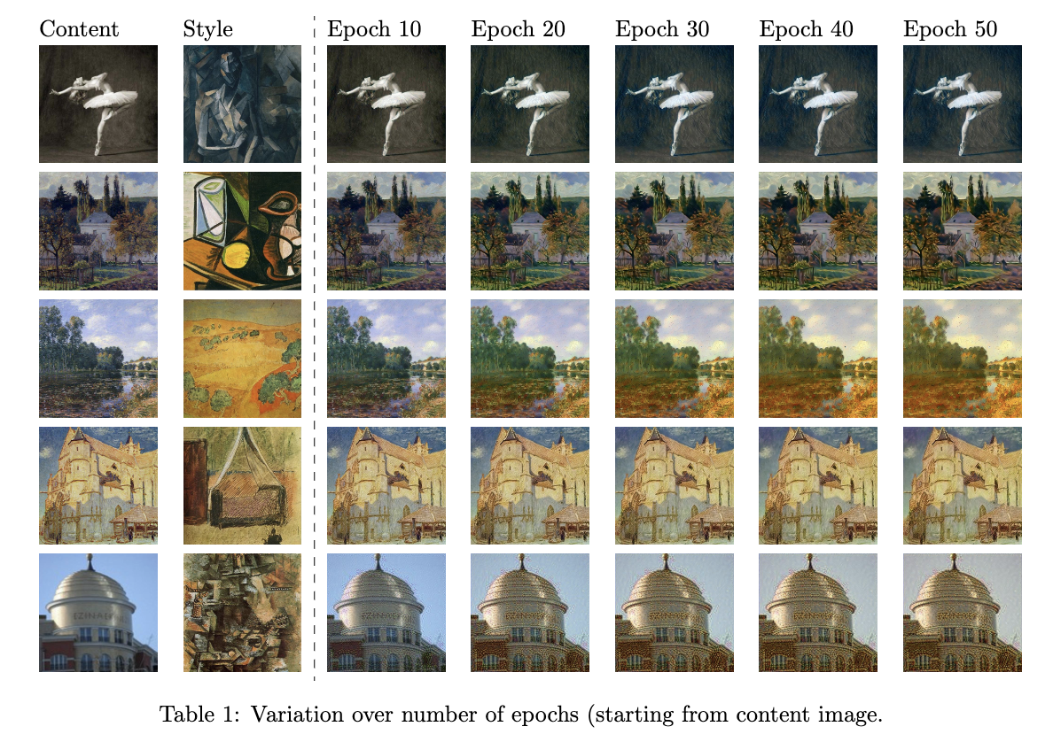
Number of Epochs (starting from content image)
We start with the content image and gradually optimise the total loss at each epoch.
As we can see from the diagram, the styles gradually gets incorporated into the image while preserving the content.

Slide 9
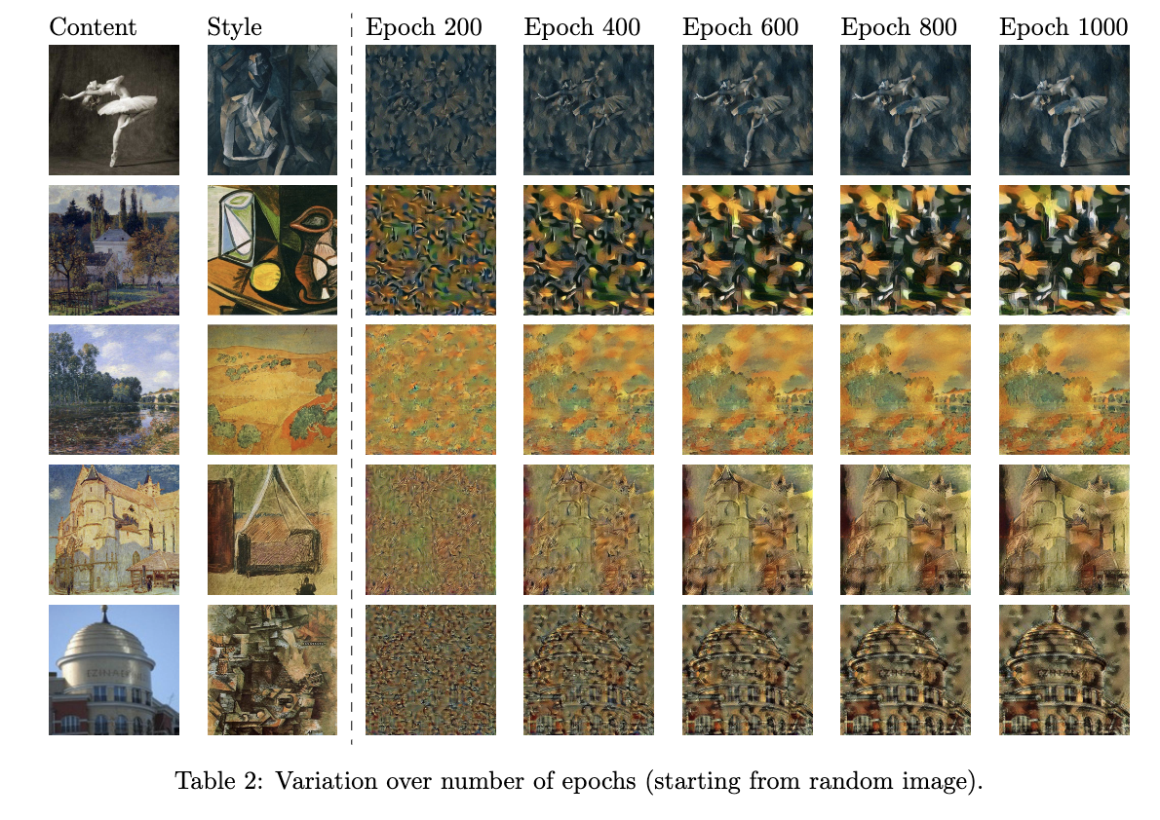
Number of Epochs (starting from random image)
Even if we start from a random (noisy) image we still get the styled image.
Starting from content image simply reduces the iterations required.

Slide 10
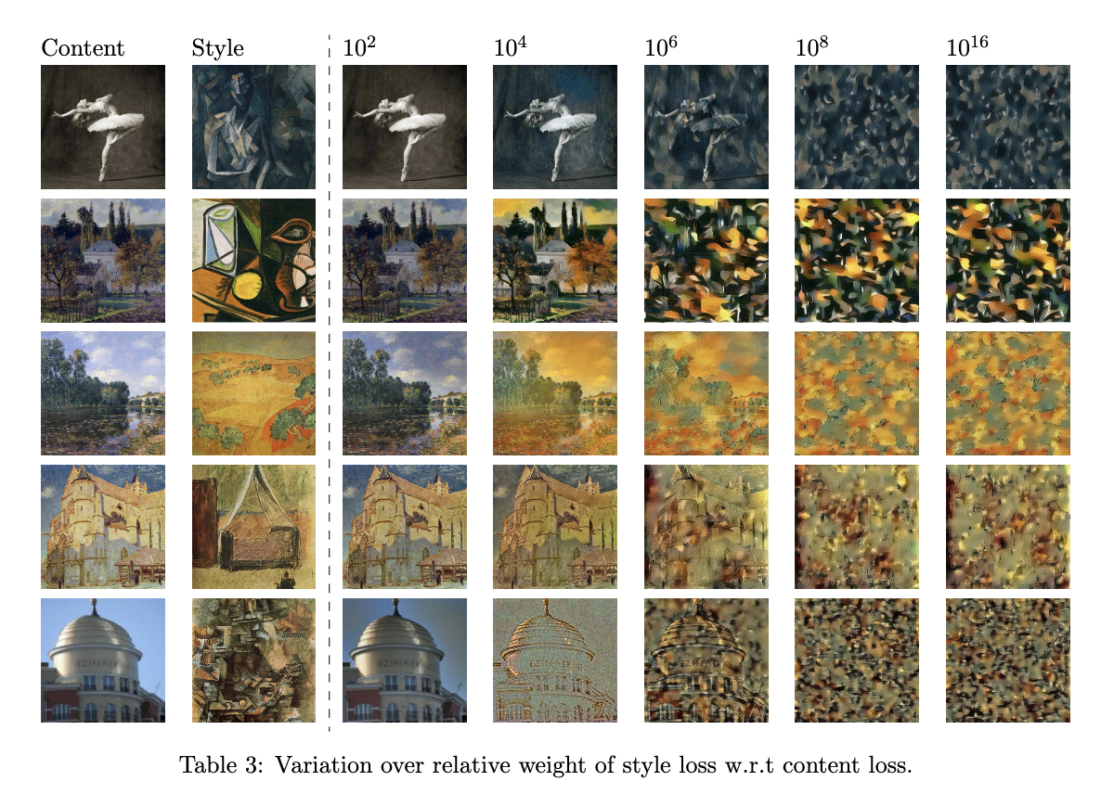
Variation of weights of style loss wrt content loss
In this experiment, we change the relative weights of content and style loss.
As expected, the resulting image has increased styling as we increase the relative weight of style loss.

Slide 11
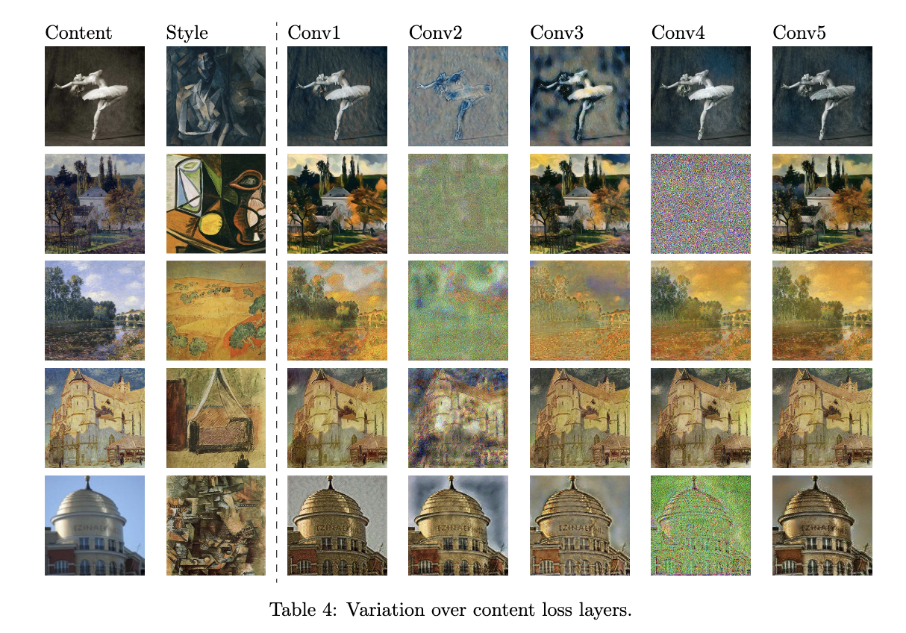
Content Loss Layers
In this experiment we change the layers over which we find that the output is highly dependant on the layer chosen.
Some layers give nicely styled image while others give noisy images.
We hypothesise that some layers capture the content well while others acts as buffers for the following layers.

Slide 12
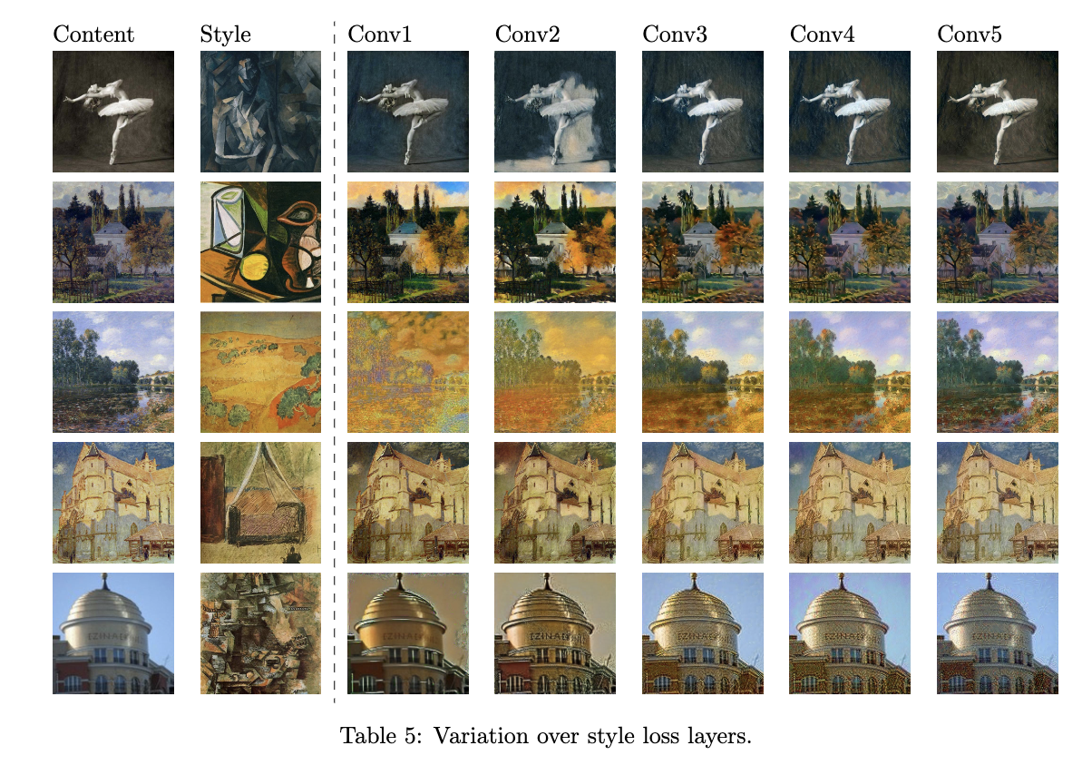
Style Loss Layers
In this experiment we change the layers over which we calculate the style loss.
We observe that style is captured better in the earlier layers.
Typically style loss is taken over few consecutive layers.

Slide 13
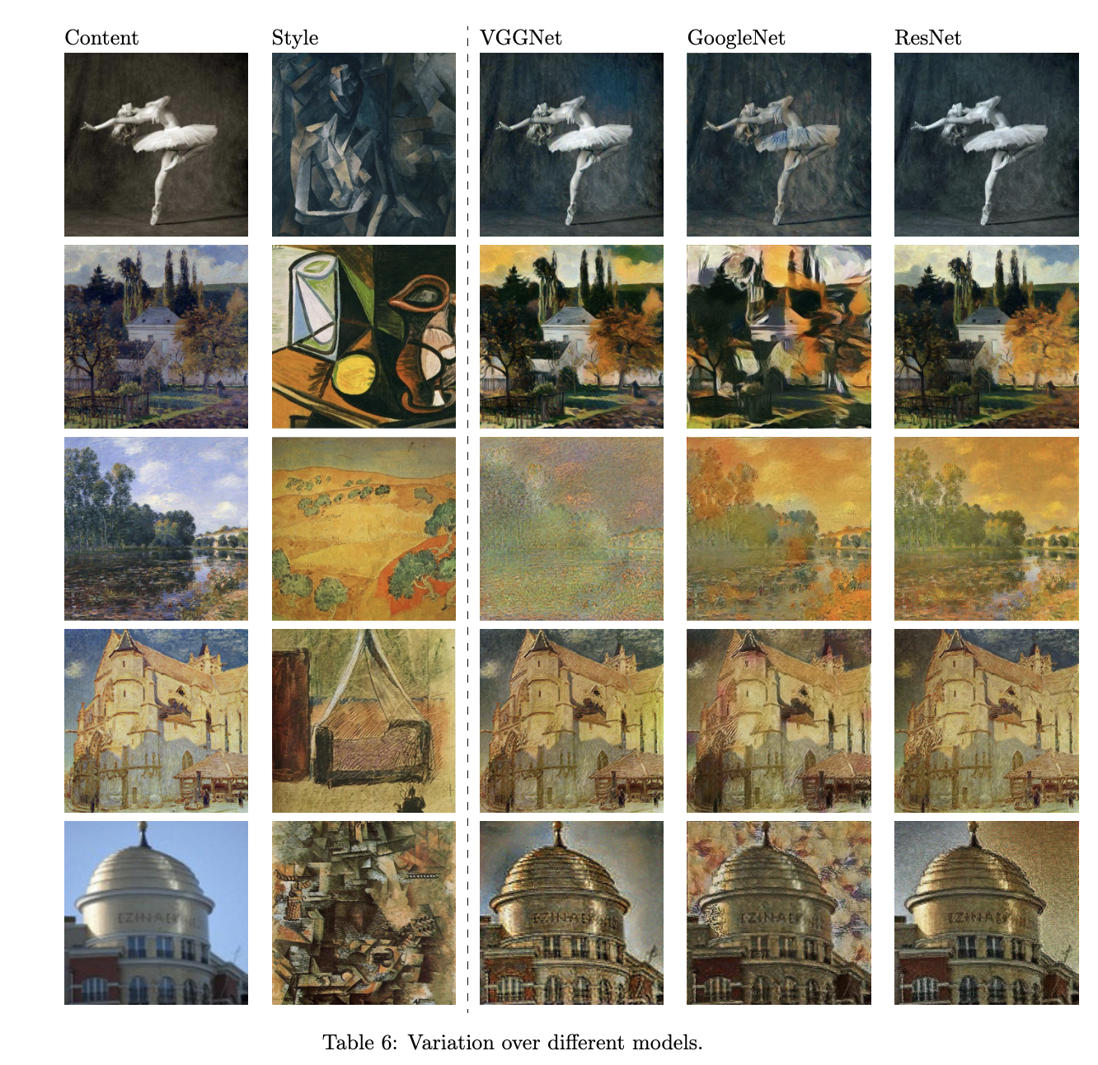
Different Model Architectures
In this experiment, we change the pretrained CNN model.
We try ResNet and GoogleNet along with VGGNet (originally).
We find that each model is able to create styled images.
However, there are subtle differences in each model.

Slide 14
Code & References
Link to the code - https://github.com/rishi1001/Neural-Style-Transfer
It contains all the details to run the code. Change the makefile to run the different experiments.
References -
A Neural Algorithm for Artistic Style, Gatys et. (https://doi.org/10.48550/arXiv.1508.06576)
Intuitive Guide to Neural Style Transfer, Towards Data Science

Slide 15
Thank You!

Slide 16
Questions?

